Slide 1
DEVELOPMENT OF CUSTOMIZED FEATURES IN A CORE BANKING SYSTEM – PROFINCH SOLUTIONS
CSE7301 Internship
Viva Voice
Mr. POKALA SIVA MANI REDDY - 20211CEI0118
Under the Supervision of,
Dr. Joe Arun Raja
Associate Professor
School of Computer Science and Engineering
Presidency University
Name of the Program: B.Tech Computer Engineering [AI & ML]
Name of the HoD: Dr. Gopal Krishna Shyam
Name of the Program Project Coordinator: Dr. P Sudha
Name of the School Project Coordinators: Dr. Sampath A K / Dr. Abdul Khadar A / Mr. Md Ziaur Rahman

Slide 2
Introduction to Profinch Solutions
Fintech company focused on banking transformation
Licensed technology partnership model
Expertise in CBS, digital banking
Global customer base with tailored services

Slide 3
Profinch’s Core Offerings
Core Banking System (CBS) Implementation
Digital Banking Customization
Extensibility and Microservices Development

Slide 4
What is a Core Banking System (CBS)?
Integrated solution for banking operations
Real-time processing: deposits, loans, payments
Enhances customer experience & reduces costs
Supports scalability & regulatory compliance

Slide 5
CBS Architecture Overview
Centralized database
Real-time transaction processing
Modular components: accounts, loans, payments
API integration with external services

Slide 6
Benefits of CBS for Banks
Increased operational efficiency
Faster customer onboarding
Seamless digital experience
Regulatory adherence

Slide 7
Enterprise Database Systems in Fintech
High-performance RDBMS platforms
Strong security and scalability
Supports mission-critical financial operations
Self-managing and multi-tenant capabilities

Slide 8
Custom Features in CBS (Profinch’s Role)
Client-specific modules and functionalities
Regulatory customizations
Integration with payment gateways
Workflow automation

Slide 9
Key Fintech Components
Core Banking System (CBS)
Payment processors and gateways
Extensibility tools
Digital banking platforms

Slide 10
Hands-on Experience in Enterprise Banking Platforms
Customizing core banking processes using configurable backend tools.
Developing business logic and workflows through a structured toolkit-driven platform.
Building digital banking interfaces with seamless backend integration.

Slide 11
Core Banking Customization
Worked on customizing enterprise-grade banking modules like deposits, loans, and customer information.
Learned to configure business workflows and validate transactions in a secure environment.
Understood end-to-end flow from backend processing to frontend banking use cases.

Slide 12
Toolkit-Based Feature Development
Developed and modified banking features using a toolkit-based low-code platform.
Focused on integrating logic through procedural units and templates.
Practiced testing and deploying customized functions in a regulated setup.

Slide 13
Digital Frontend Integration
Designed user-friendly digital banking interfaces connected to backend core systems.
Built responsive and API-driven modules for services like fund transfers and account summaries.
Ensured consistency across channels (web/mobile) through session handling and secure access.

Slide 14
Tools & Technologies Mastered in Fintech Development
PL/SQL – Wrote stored procedures to implement backend rules for customer verification, loan logic, and reporting.
Spring Framework (Java) – Built backend services for internal APIs, configured controllers, and managed service layers.
Secure Log File Retrieval - Used SFTP protocols with GUI tools to download application logs for troubleshooting and performance analysis.
Enterprise Application Server Administration – Managed deployment cycles, tuned resource pools, and monitored backend application health via server management consoles.
Postman – Executed secured HTTP requests to test custom-built endpoints; validated headers, tokens, and payloads for service integration.
Spring Tool Suite (STS IDE) – Managed full-stack Java application code, debugged API issues, and configured environment-specific .yml and .properties files.
JD-GUI (Java Decompiler) – Reverse-engineered compiled .jar files to inspect legacy code and trace business logic for error resolution.

Slide 15
Extensibility Tools & Microservices
Rapid feature deployment
Enhances modularity and agility
Facilitates continuous integration and delivery
Improves maintainability

Slide 16
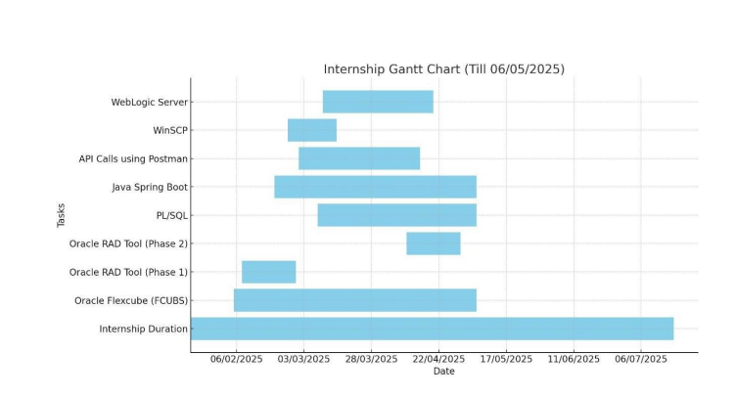
Timeline of Project

Slide 17
Conclusion
The internship offered valuable hands-on experience with Core Banking Solutions (CBS), deepening understanding of essential banking operations such as account management, transaction processing, and compliance. Working with relational databases and PL/SQL enhanced skills in managing financial data effectively. Exposure to enterprise-level architecture highlighted how different components integrate to create scalable and secure banking systems. Interns gained practical knowledge of modern software development practices through microservices, Spring Boot, and low-code tools, emphasizing modularity, security, and efficiency. Additionally, experience with API management and testing using Postman strengthened the ability to ensure seamless system communication, critical for fintech platforms relying on third-party integrations. Overall, the internship provided a solid foundation in CBS and fintech technologies within a licensed financial environment, preparing interns for real-world challenges in banking technology and fintech development.

Slide 18
Github Link
The Github link provided should have public access permission.
Github Link
https://github.com/SivaMani-21

Slide 19
References
[1] Core Banking Systems: Foundations of Modern Financial Services. (2025). Retrieved from https://example.com/core-banking-systems
[2] Comprehensive Overview of Core Banking Product Suites. (2025). Retrieved from https://example.com/core-banking-products
[3] Building Microservices with a Modern Java Framework. (2025). Retrieved from https://example.com/microservices-java-framework
[4] Understanding Toolkits for Accelerated Software Development. (2025). Retrieved from https://example.com/toolkits-software-development
[5] Enterprise Application Servers: Architecture and Deployment. (2025). Retrieved from https://example.com/enterprise-app-servers
[6] Secure File Transfer Clients for Development Environments. (2025). Retrieved from https://example.com/sftp-ftp-client
[7] Procedural SQL Techniques for Financial Applications. (2025). Retrieved from https://example.com/procedural-sql
[8] API Platforms for Modern Software Development. (2025). Retrieved from https://example.com/api-platforms
[9] High-Performance Databases for Financial Workloads. (2025). Retrieved from https://example.com/finance-databases
[10] Enterprise System Architecture for Financial Institutions. (2025). Retrieved from https://example.com/enterprise-finance-architecture

Slide 20
References
[11] Anjali R. Nair. (2024). Integration of core banking systems with modern digital banking layers for omnichannel services. The study highlights REST API and middleware communication, transactional improvements, and security frameworks for scalable digital transformation. Retrieved from https://example.com/digital-banking-architecture
[12] Rajeev Kumar and Meenal Deshpande. (2023). Middleware platforms for enhancing performance and fault tolerance in enterprise financial applications. The paper analyzes load balancing, session persistence, and enterprise component usage in clustered core banking environments. Retrieved from https://example.com/middleware-performance-fintech
[13] Sneha Murthy. (2025). Extensibility toolkits and procedural programming for customized fintech workflows. Case studies illustrate rapid development of banking processes using stored procedures and toolkits, emphasizing secure integration and compliance. Retrieved from https://example.com/fintech-toolkit-development

Slide 21

Project work mapping with SDG
Goal 4 – Quality Education Hands-on learning through real-world banking and fintech projects. Practical exposure to technologies like core banking systems, payment processors, and Spring Boot enriched your technical education.
Goal 5 – Gender Equality Promotes inclusive workplace culture and collaboration regardless of gender. Equal opportunity to learn, grow, and contribute in a professional environment.
Goal 8 – Decent Work and Economic Growth Contributed to fintech innovations that support efficient banking operations. Built professional skills and work ethics needed for economic productivity.

Slide 22
Fhgjkl;
Thank You

